Slide 1

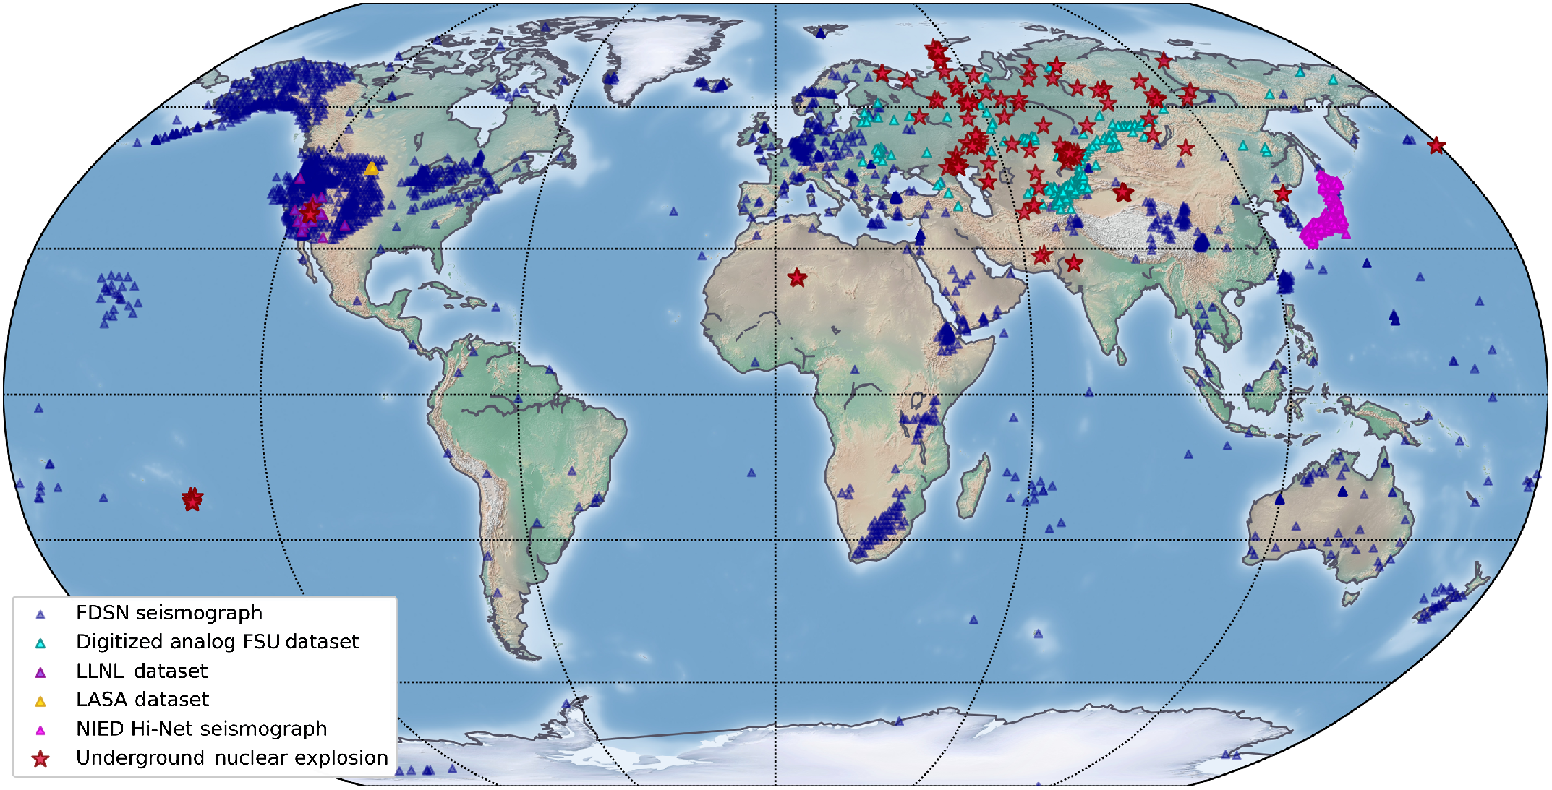
From: GTUNE: An Assembled Global Seismic Dataset of Underground Nuclear Test Blasts
Seismological Research Letters. 2022;93(6):3514-3523. doi:10.1785/0220220036
^{Figure Legend:}
Global map of all underground nuclear explosions (UNE) included in the Georgia Tech Underground Nuclear Explosions (GTUNE) data. Multiple UNEs (red stars) frequently recur at or near the same location. Recording seismic stations (triangles) are also shown, with colors differentiating data sources: International Federation of Digital Seismograph Networks (FDSN) (black), digitized former Soviet Union (FSU) (teal; Richards et al., 1992), Lawrence Livermore National Laboratory (LLNL) (purple; Walter et al., 2004), and National Research Institute for Earth Science and Disaster Resilience (NIED) (pink; NIED, 2019). The color version of this figure is available only in the electronic edition.
^{Date of download: 11/13/2023}
© Seismological Society of America

